Slide 1
Modeling brainstem respiratory center
from single pacemaker to network
Huanan Shi
Baylor College of Medicine

Slide 2
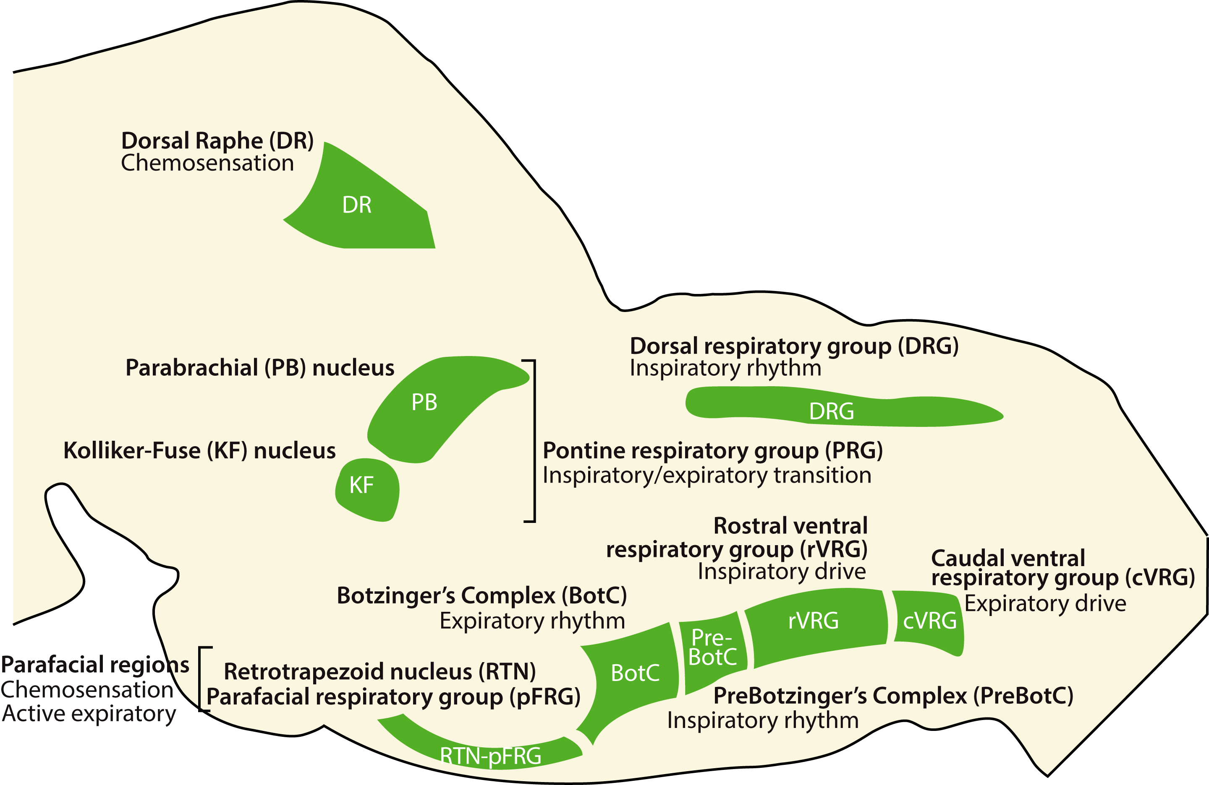
Overview of Brainstem Respiratory Center
Notes:
central CO2-chemoreception and for gating active expiration
Ventral medulla

Slide 3
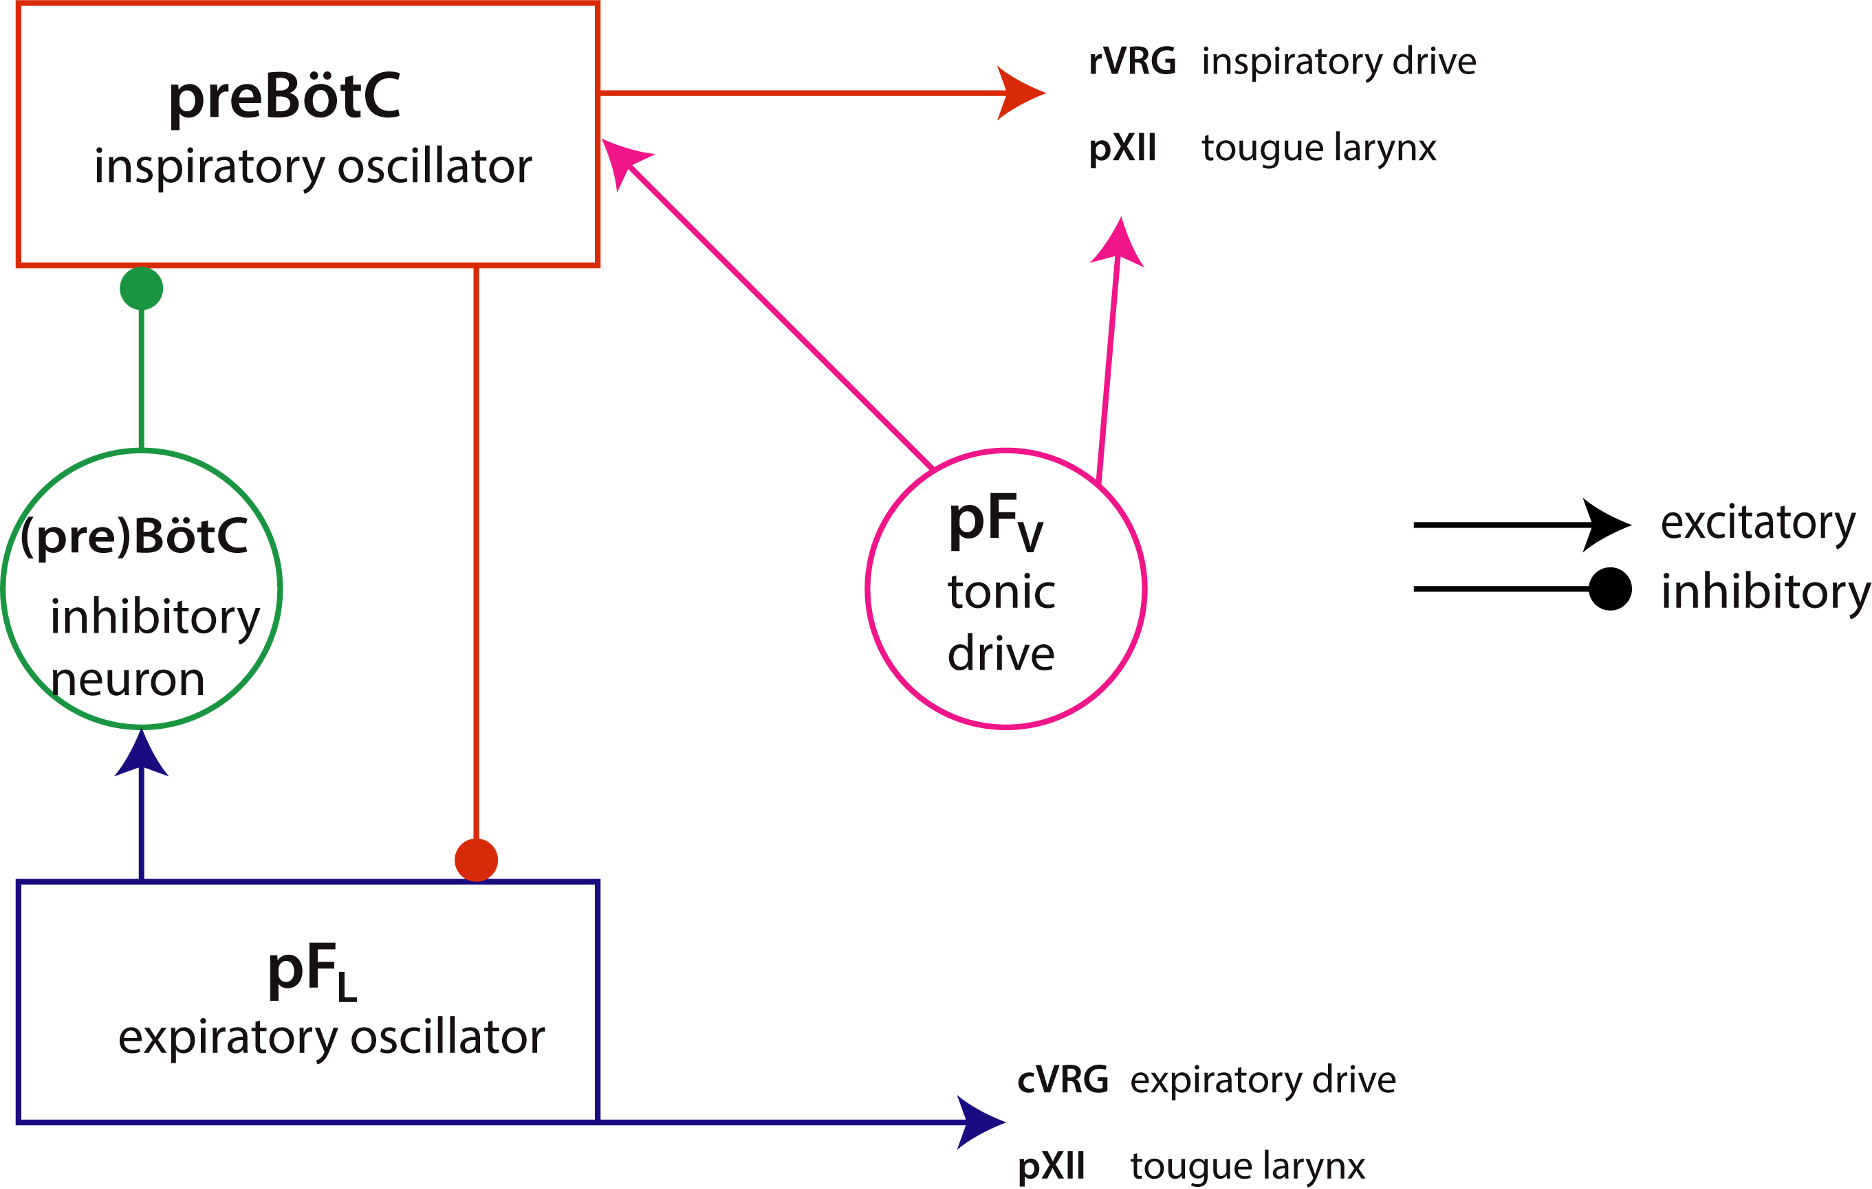
Respiratory Rhythm Generation
(Modified from Huckstepp et al, JNeuro2017)
Notes:
Neurons in PreBötC serves as pacemaker, Disinhibition of lateral parafacial nuclei led to active expiration, hypoglossal
Ventral pF as tonic drive, all three contribute to excitation of cranial nerve 12. here we simplified the system by put pFv as an excitatory tonic drive as part of preBötC model

Slide 4


Single pacemaker model
Inspiratory pacemaker with fast-activating, slow inactivating persistent Na⁺ current.
Membrane potential V_{m}:
For gating variable n, h:
(Butera et al. 1999a)
Notes:
It is a simple Hodgkin-Huxley model Activation function and time constant

Slide 5
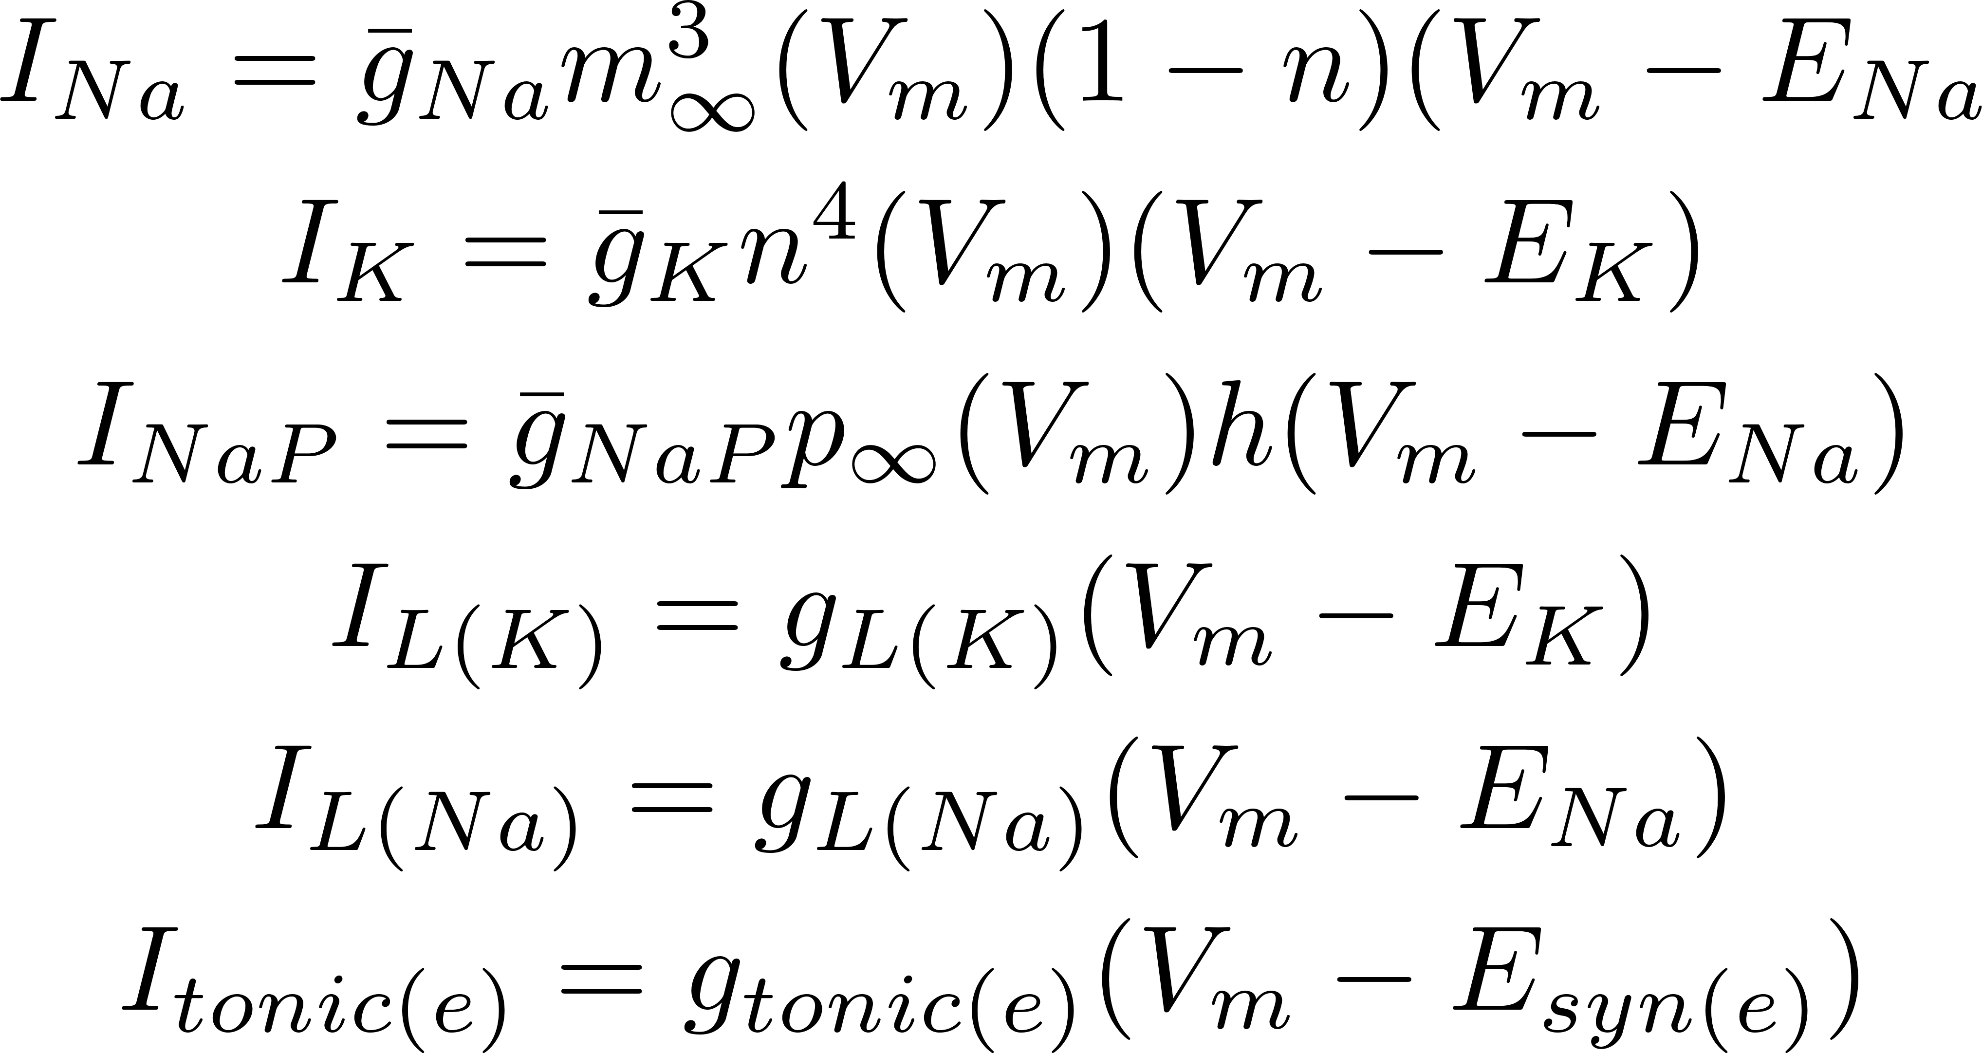
Notes:
tonic(e) is synaptic tonic drive of non-NDMA excitatory amino-acid receptors
n is fast changing

Slide 6
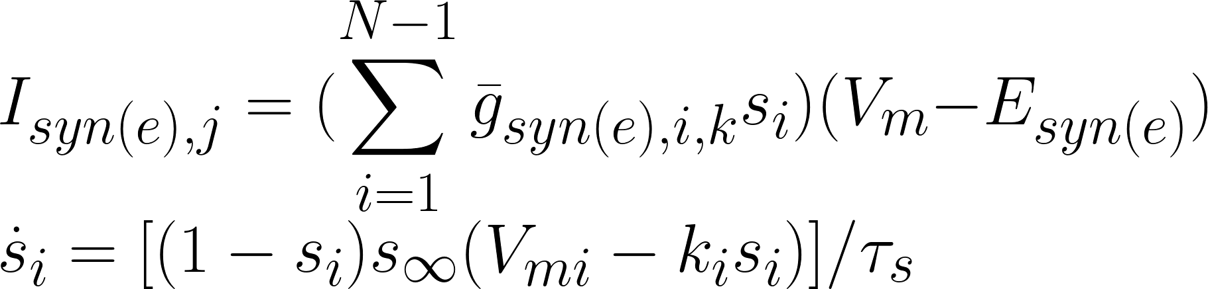
Pacemaker network (N pacemakers)
Neuron j in preBötC receives excitatory inputs from N-1 non-j neurons:
It is incorporated into single neuron model.
To incorporate heterogeneity in pacemaker neurons, conductance
will be randomly assigned from normal distribution
Notes:
Here I assume every neuron is coupled with each other.

Slide 7

Follower Cells
For non-pacemaker follower cells, like pXII neurons,
The probability of synaptic connection between pacemaker neurons and follower neurons is 0.5

Slide 8
Respiratory Rhythm Generation
(Modified from Huckstepp et al, JNeuro2017)
Notes:
As mentioned here, There is inhibitory synapse between preBötC neuron and expiratory pacemaker. Thus, the I_{syn(i)} with a opposite direction of I_{syn(e)}, will be added to the single cell model.
Expiratory pacemaker will only be activated when tonic drive is large enough. When activated, expiratory pacemaker will give a inhibitory signaling to inspiratory pacemaker via an inhibitory neuron with a time delay and will contribute to pXII neurons.

Slide 9
Follower Cells
For non-pacemaker follower cells, like pXII neurons,
The probability of synaptic connection between pacemaker neurons and follower neurons is 0.5
There is inhibitory synapse between preBötC neuron and expiratory pacemaker. Thus, the I_{syn(i)} with a opposite direction of I_{syn(e)}, will be added to the single cell model.
Expiratory pacemaker will only be activated when tonic drive is large enough. When activated, expiratory pacemaker will give a inhibitory signaling to inspiratory pacemaker via an inhibitory neuron with a time delay and will contribute to pXII neurons.
Numerical method
Trapezoid rule will be used to solve this model.

Slide 10
Questions?
Notes:
What is the aim?
Why model it?
Why original Butera model is not enough

